Slide 1
PPs with gaps in
Craig Sailor James Griffiths
University of Cambridge Universiteit Utrecht
cwsailor@gmail.com jamesegriffiths@gmail.com
LAGB 2015, 18/09/2015

Slide 2
Introduction
1
Optionally, in certain dialects of BrE:
(1) a. This film has monsters in _.
b. The film with monsters in _ was scary.
c. Those tables have stools beneath _.
d. Those tables with stools beneath _ are dirty.
e. Canals always have bridges across _ in Holland.
f. Canals with bridges across _ are common here.
Prepositional object gaps (POGs)
Notes:
Point of unreported dialectal variation within English. Blue represents coreference. Gaps aren’t permitted in AmE, for instance; would surface as pronouns.

Slide 3
Introduction
2
In this talk:
Outline the principle licensing constraint on POGs
POGs = tails of A-movement chains
“POG vs. non-POG” = variation in features on a single functional syntactic head
Notes:
“keep the local structure constant” – i.e. use local structures that all speakers of POG-dialects would accept in ideal environments.

Slide 4
An aside: variability
3
(2) The next bus stop has a Nando’s just past _, so let’s go there for lunch.
(cf. Griffiths & Sailor, to appear)
Notes:
Variability within POG-dialects still unclear to us. Variability usually concerns which P is used. E.g. “past” runs the whole gamut of judgements.

Slide 5
Principle licensing constraint
4
(1) a. This film has monsters in _.
b. The film with monsters in _ was scary.
c. Those tables have stools beneath _.
d. Those tables with stools beneath _ are dirty.
e. Canals always have bridges across _ in Holland.
f. Canals with bridges across _ are common here.

Slide 6
Principle licensing constraint
4
(1) a. This film has monsters in _.
b. The film with monsters in _ was scary.
c. Those tables have stools beneath _.
d. Those tables with stools beneath _ are dirty.
e. Canals always have bridges across _ in Holland.
f. Canals with bridges across _ are common here.

Slide 7
Principle licensing constraint
5
(3) a. Don’t watch that film – there’s a monster in *(it)!
b. I won’t watch that film because a monster is in *(it).
c. See that table? Look at the cute dog beneath *(it)!
d. A church’s cemetery can usually be found behind *(it).
e. The film’s production crew are all in *(it).
f. This table’s stools are beneath *(it).
A have/with possessive superstructure is required for licensing POGs.
Notes:
Important to remember that POGs are only licensed in possessive HAVE/WITH environments. We’ll return to this later…

Slide 8
Nature of the gap
6
What are POGs?
Null elements (topic drop)?
Tails of A′-movement chains?
Tails of A-movement chains?

Slide 9
POGs as null elements?
7
English does permit null PP-internal elements
Null PPs
(4) I drank at the pub with the most people inside (of it).
(5) That film was a just remake with the plot taken away (from it).
Null pronouns (cf. Svenonius 2010)
(6) We’re going on to the next pub now, but John is staying behind (?us).
(7) There are olive trees growing in the valley below (us/here).
Notes:
Should be skeptical: the null PPs are not pronouns (unlike POGs), and the pronoun cases seem somewhat conventionalized.
IMPORTANT: okay in all dialects.
Could say that POGs are a dialectic-specific extension of this topic-drop phenomenon, but we’ve already seen that not all environments allow POGs (only have/with possessives). Also, movement facts make us more skeptical…

Slide 10
POGs as null elements?
8
(10) Which president did you read [a book about _] with torn pages in it?
(11) * Which president did you read [a book about _] with torn pages in _?
The unacceptability of (11) is suggestive of a derived island violation (Wexler & Culicover 1980)
(12) * Which president_{j} did you read [a book about __{j}]_{i} with torn pages in __{i}?

Slide 11
POGs as tail of A′-movement?
9
(13) The box {with/ has} a skunk in t … (akin to relativisation)
Would violate the Improper movement condition (Chomsky 1973)
(14) This box seems t to have a skunk in t.
A-movement
A′-movement

Slide 12
POGs as tails of A′-movement?
10
No weak crossover effects
(15) The car with its own number plate in t …
No parasitic gaps
(16) John filed the papers with doodles on t without having read *(them).

Slide 13
POGs as tails of A-movement?
11
Consistent with no weak crossover; feeds pronominal binding
(15) The car with its own number plate in t …
Consistent with raising facts:
(14) This box seems t to have a skunk in t.
A-movement
A-movement
Notes:
Raising across experiencer: “John seems to himself to be the best.” At end of slide: SUMMARISE.
Topic drop infeasible because not dialect specific, and wouldn’t explain the derived island data.
A’-movement impossible because there’s no weak crossover effects, cases of improper movement, no licensing of parasitic gaps.
A-movement analysis seems most consistent with the data we’ve gathered so far.

Slide 14
Interim summary
12
Empirical observations
POGs are only licensed in certain dialects of BrE
POGs are only licensed in have/with possessive superstructures
Hypothesis
POGs are tails of A-movement chains

Slide 15
Analysis
13
Observations so far are suggestive of an analysis that involves:
A united account of have and with possessives
A trigger for A-movement that can be subject to dialectal variation

Slide 16
Unified analysis of have / with
14
Possessive have and with constructions both involve P_{poss}, which incorporates into a case-assigning head (either v or p). (Levinson 2011)
P_{poss} may select for prepositional small clause complements

Slide 17
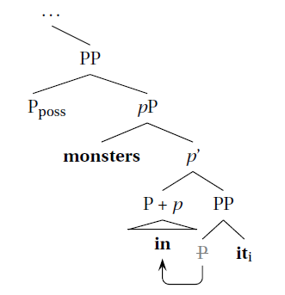
Unified analysis of have / with
15
If selected by v = has
If selected by p = with
Notes:
Levinson (2011): possessive HAVE is a copular construction that selects for a possessive PP.
The P-poss incorporates up to little v, which extendes the case-domain far enough for monsters to get assigned case. Spelled-out as HAVE. P-poss selects for pP complement.
On the assumption that the same incorporation happens with all lexical Ps (nothing rests on this assumption for us…), we see the same phenomenon in the lower PP domain.

Slide 18
Dialectal variation and a trigger for A-movement
16
Dialectal variation
(following Kayne 2000, Barbiers 2009, Corver & van Koppen 2011, Zanuttini & Horn 2014)
(A) cat P_{poss} (B) cat P_{poss}
infl … infl …
sel pP_{[+case]} sel pP_{[-case]}
POG-dialects: A, B
Other Englishes: A
Notes:
We attribute dialectal variation to a single functional head. We saw how case we licensed with the (A) case, now let’s look at the (B) case...

Slide 19
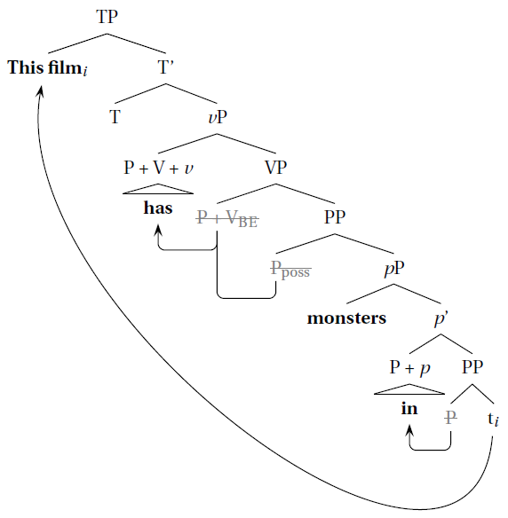
A derivation for POG constructions
17
(17) This film has monsters in t.

Slide 20
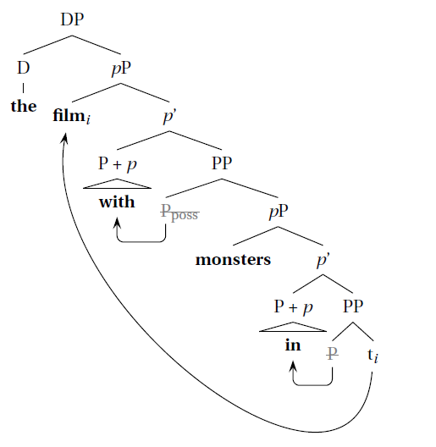
A derivation for POG constructions
18
(18) The film with monsters in t …
Notes:
No intervention effect: ACC is assigned before A-movement.
‘Defective’ intervention effect? Unlikely that they exist – see Breuning 2014.

Slide 21
Conclusion
19
POGs are tails of A-movement chains
A-movement is triggered for Case-assignment
P_{poss} is the locus of dialectal variation

Slide 22
References
20
Barbiers, S. 2009. Locus and limits of syntactic microvariation. Lingua 119:1607-1623
Bruening, B. 2014. Defects of defective intervention. Linguistic Inquiry 45(4): 707-719
Chomsky, N. 1973. Conditions on transformations. In S. Anderson & P. Kiparsky (eds.), A Festschrift for Morris Halle. Holt, Reinhart and Winston, New York. 232-286
Corver, N. & M. van Koppen. 2011. NP-ellipsis with adjectival remnants: A micro-comparative perspective. Natural Language and Linguistic Theory 29: 371-421.
Fox, D. 2000. Economy and semantic interpretation. Cambridge, MIT Press.
Griffiths, J. & C. Sailor. Prepositional object gaps in British English. To appear in Linguistics in the Netherlands 32.
Johnson, K. 2009. Gapping is not (VP) Ellipsis. Linguistic Inquiry 40(2), 289-328.
Kayne, R. 2000. Parameters and Universals. Oxford: OUP.
Levinson, L. 2011. Possessive WITH in Germanic: HAVE and the Role of P. Syntax 14(4): 355–393
Lin, V. 2002. Coordination and sharing at the interfaces. Doctoral Dissertation, MIT.
Ross, J. 1967. Constraints on variables in syntax. Doctoral Dissertation, MIT.
Svenonius, P. 2010. Spatial P in English. In G. Cinque & L. Rizzi (eds.) Mapping Spatial PPs. Oxford Studies in Comparative Syntax. Oxford: OUP. 127-160
Wexler, K. & P. Culicover. 1980. Formal Principles of Language Acquisition. Cambridge, MIT Press.
Zanuttini, R. & L. Horn. 2014. Micro-syntactic variation in North American English. Oxford Studies in Comparative Syntax. Oxford: OUP.

Slide 23
Appendix: POGs and the CSC
21
No violation of Coordinate Structure Constraint (CSC, Ross 1967)
(19) This teapot has a big [_{&P} [tea-cosy on _] and [lots of tea in it].
(20) This teapot has a big [_{&P} [tea-cosy on it] and [lots of tea in _].
‘Unequal’ A-movement from &P does not violate the CSC
(Fox 2000, Lin 2002, Johnson 2009)
(21) John can’t [_{&P} [_{vP} t dance] or [_{vP} Mary sing]]. (Johnson 2009:9)

